Slide 1
Machine Learning with Python

Slide 2
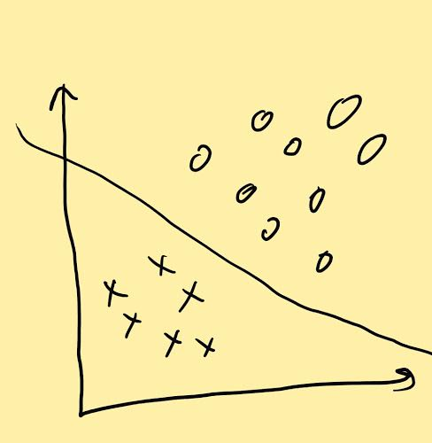
Support Vector Machines(SVM)
SVM is a supervised machine learning approach used to build linear, non-probabilistic binary classifiers.
It makes the classification decision based on a linear function
It does not involves any assumptions about the distribution of data
SVM finds a hyper-plane that cuts the data points into 2 categories. It’s a decision surface determined by observing the data points

Slide 3
Support Vector Machines(SVM)
The equation describing the hyper-plane will be as follows:
D = Ax + By + Cz
All points on one side of the plane will satisfy the condition
Ax + By + Cz > D
All points on the other side of the plane will satisfy the condition
Ax + By + Cz < D
SVM will choose that decision boundary which has maximum distance from the closest data point on either side of boundary. This distance is called “margin”. So SVM tries to maximize the “margin”.
Support vectors are simply the “nearest data points” on each side which “support” the hyperplane.
SVM is like a solver to an optimization problem. The objective function here is to find the decision boundary. The constraint is that it should not misclassify the data points.

Slide 4
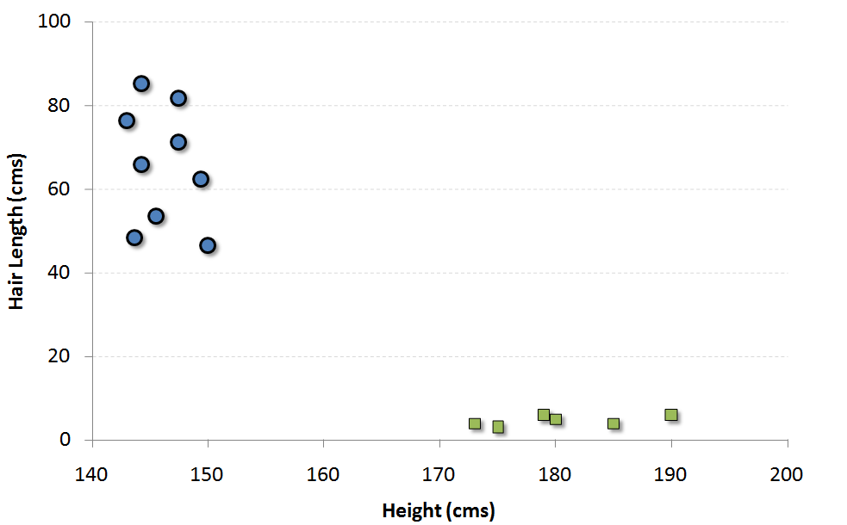
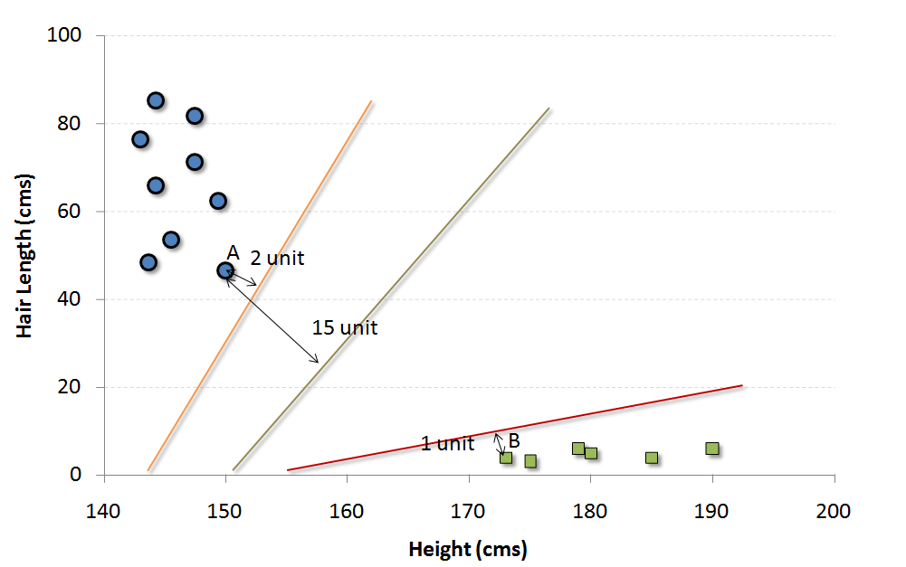
SVM - Example
The blue circles in the plot represent females and green squares represents male. A few expected insights from the graph are :
1. Males in our population have a higher average height.
2. Females in our population have longer scalp hairs.
If we were to see an individual with height 180 cms and hair length 4 cms, our best guess will be to classify this individual as a male.
The easiest way to interpret the “objective function” in a SVM is to find the minimum distance of the frontier from closest support vector (this can belong to any class). For instance, orange frontier is closest to blue circles. And the closest blue circle is 2 units away from the frontier. Once we have these distances for all the frontiers, we simply choose the frontier with the maximum distance (from the closest support vector). Out of the three shown frontiers, we see the black frontier is farthest from nearest support vector (i.e. 15 units).

Slide 5
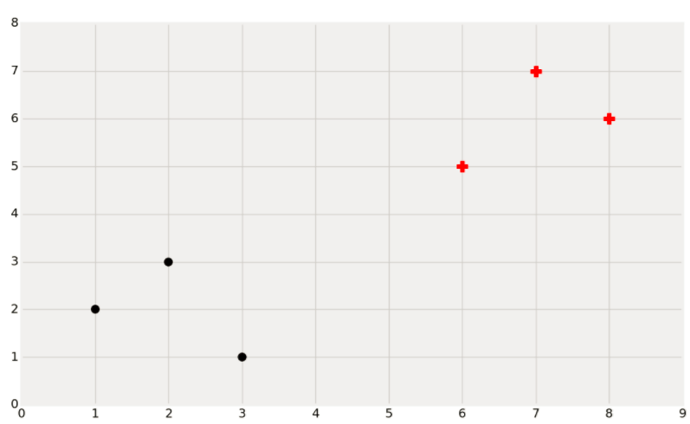
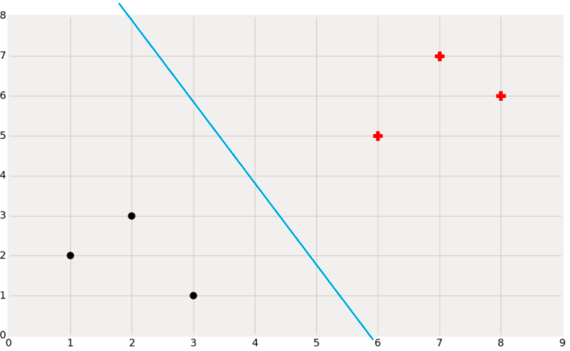
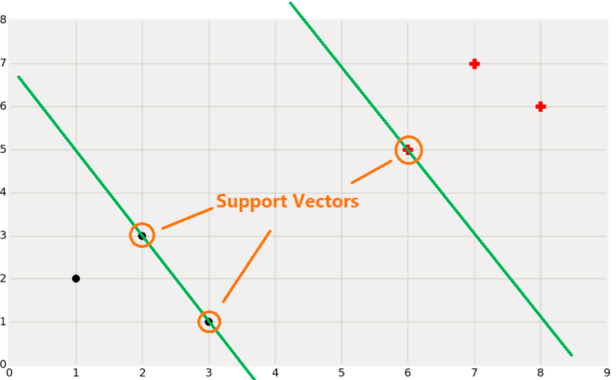
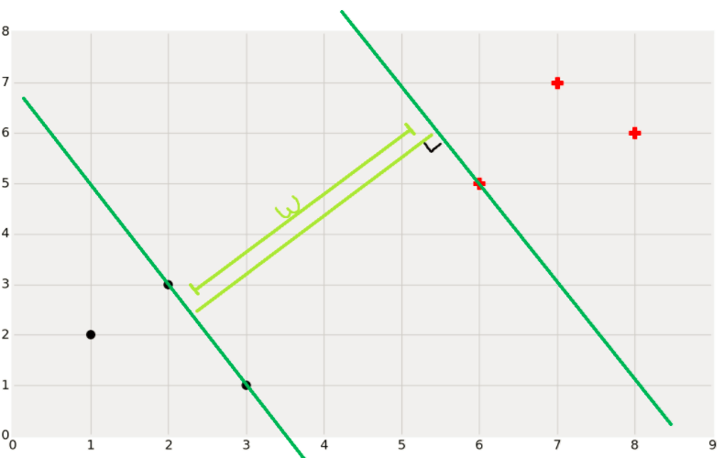
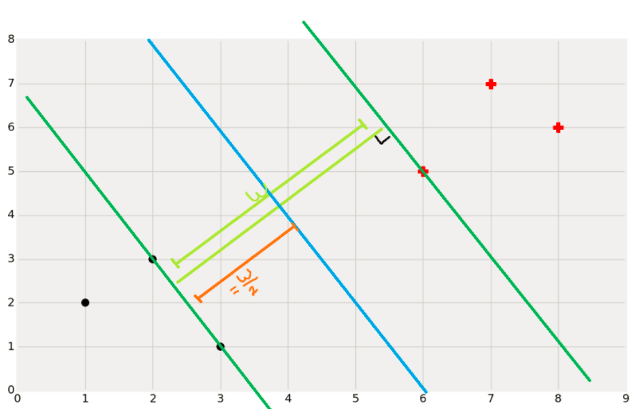
SVM - Example

Slide 6
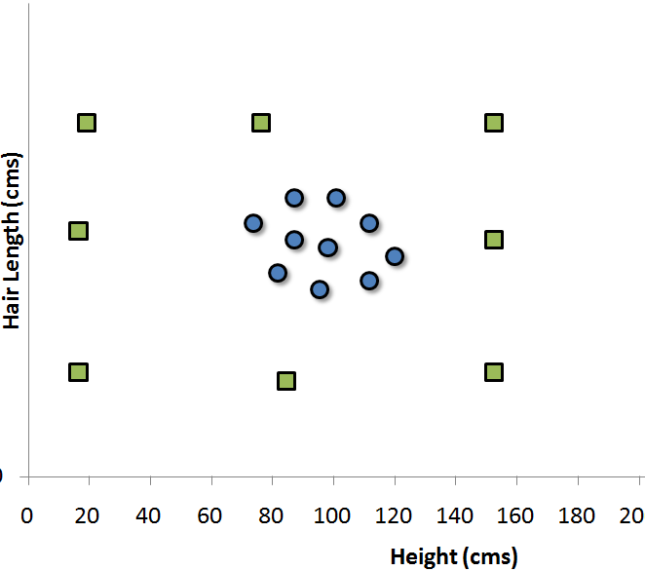
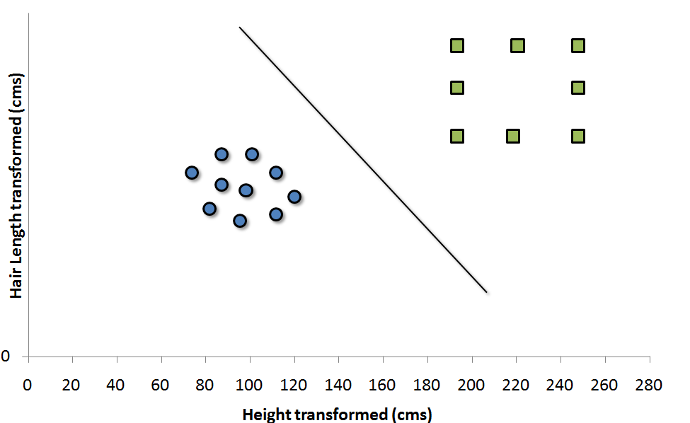
Non-Linear SVM
If the distribution of data points is such that its impossible to find linear separation between the 2 clusters, then we need to map these vector to a higher dimension plane so that they get segregated from each other.
Each of the green square in original distribution is mapped on a transformed scale. And transformed scale has clearly segregated classes.

Slide 7
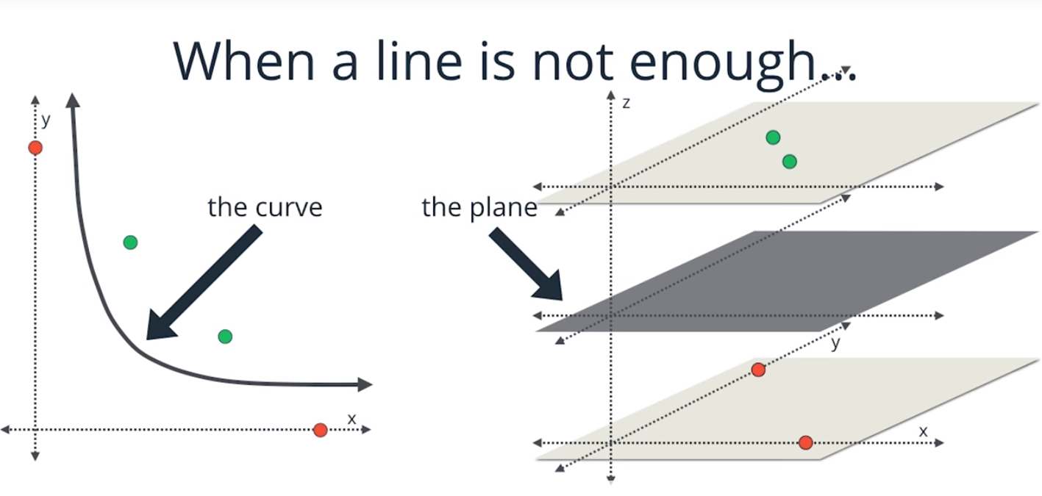
Non-Linear SVM

Slide 8
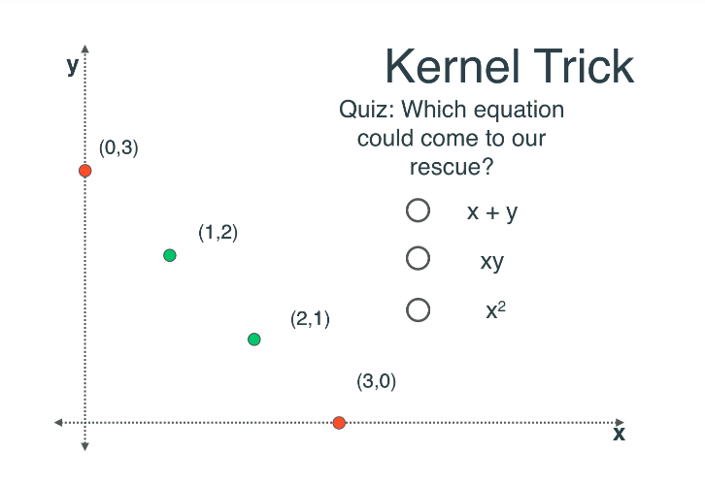
Non-Linear SVM

Slide 9
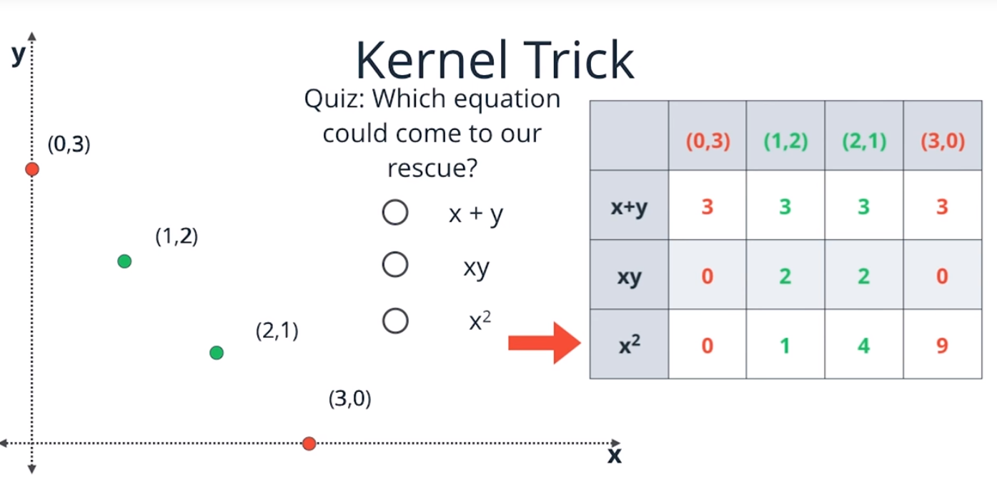
Non-Linear SVM

Slide 10
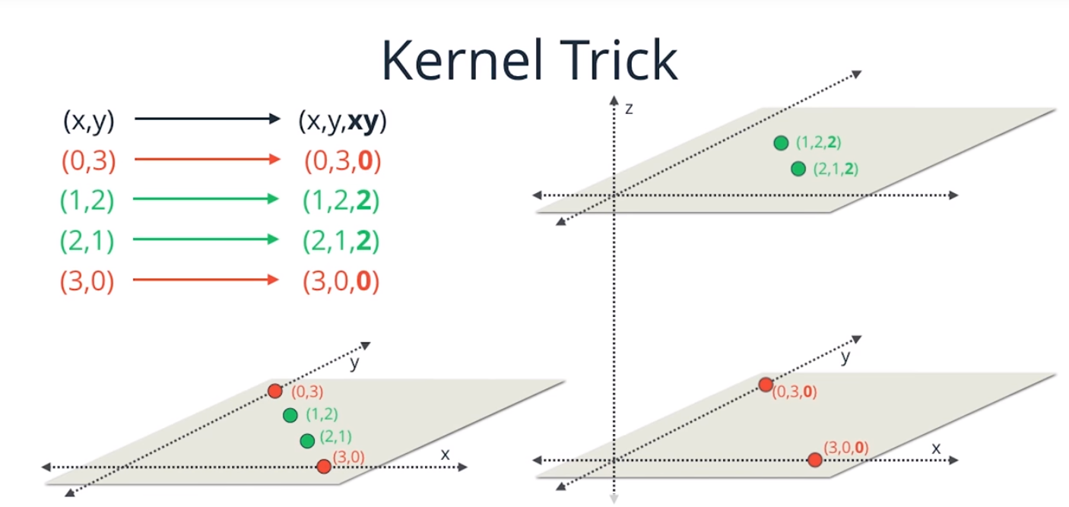
Non – Linear SVM

Slide 11
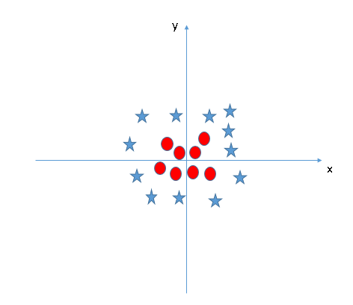
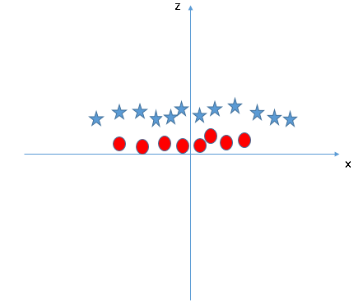
Non-Linear SVM - Example
Z = x^2 + y^2
SVM uses “kernel” functions which take low dimensional input space and transform it to a higher dimensional space

Slide 12
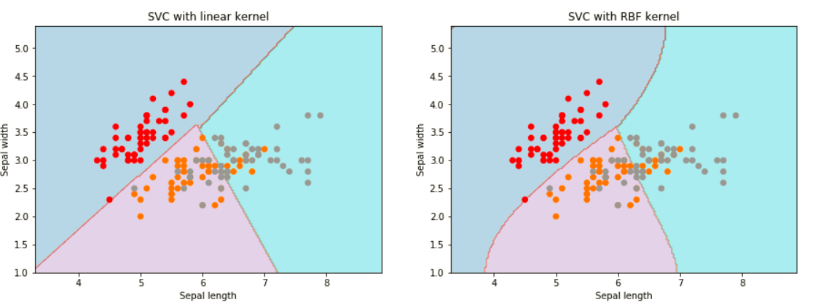
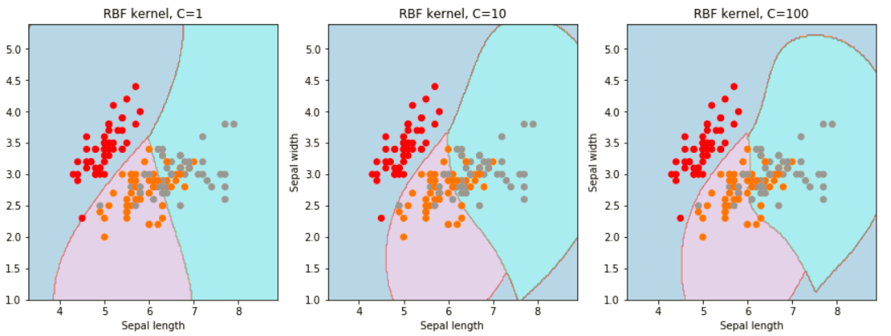
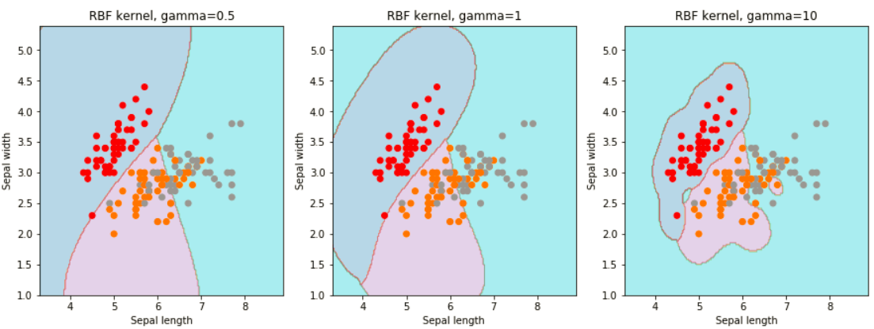
SVM Parameters
Kernel : It defines the function to transform low dimensional input space into higher dimension
Gamma: It defines how far the influence of a single training example reaches
C: It controls the trade-off between smooth decision boundary and classifying training points correctly.

Slide 13
SVM Pros and Cons
Pros:
It works really well with clear margin of separation
It is effective in high dimensional spaces.
It is effective in cases where number of dimensions is greater than the number of samples.
It uses a subset of training points in the decision function (called support vectors), so it is also memory efficient.
Cons:
It doesn’t perform well, when we have large data set because the required training time is higher
It also doesn’t perform very well, when the data set has more noise i.e. target classes are overlapping

Slide 14
Parametric vs Non Parametric
Assumptions can greatly simplify the learning process, but can also limit what can be learned. Algorithms that simplify the function to a known form are called parametric machine learning algorithms. The algorithms involve two steps:
Select a form for the function.
Learn the coefficients for the function from the training data.
Some examples of parametric machine learning algorithms are Linear Regression and Logistic Regression.
Algorithms that do not make strong assumptions about the form of the mapping function are called nonparametric machine learning algorithms. They are also known as Instance-based methods. By not making assumptions, they are free to learn any functional form from the training data.
Non-parametric methods are often more flexible, achieve better accuracy but require a lot more data and training time.
Examples of nonparametric algorithms include k-NN, Support Vector Machines, Neural Networks and Decision Trees.

Slide 15
Vector Algebra
Point: A point is a location in space. Its written as (x,y,z)
Vector: Its an object that represents a change in location. It has 2 properties: Magnitude and Direction
Normalization: process of finding a unit vector in the same direction as given vector.
A “vector” is a quantity that has a direction associated with it e.g Velocity, Displacement etc
Lets assume, a vector represents “growth” in a direction. You can do following operations :
Add vectors: Accumulate the growth contained in several vectors.
Multiply by a constant: Make an existing vector stronger.
Dot product: Apply the directional growth of one vector to another. The result is how much stronger we've made the original (positive, negative, or zero).
The dot product tells you what amount of one vector goes in the direction of another. It is “multiplication” taking direction into account.
Lets say you have two numbers: 5 and 6. Lets treat 5X6 as dot product
(5,0) . (6,0)
The number 5 is "directional growth" in a single dimension (the x-axis, let's say), and 6 is "directional growth" in that same direction. 5 x 6 = 30 means we get 30 times growth in a single dimension.

Slide 16
Vector Algebra
Now, suppose 5 and 6 refer to different dimensions. Let's say 5 means “Buy me 5 times the bananas" (x-axis) and 6 means “Buy me 6 times your oranges" (y-axis). Now they're not the same type of number: what happens when apply growth (use the dot product) in our "bananas, oranges" universe?
(5,0) means “Five times your bananas, destroy your oranges"
(0,6) means "Destroy your bananas, 6 times your oranges“
Applying (0,6) to (5,0) means destroy your banans but buy your oranges 6 times the original number. But (5,0) has no oranges to begin with. So net result is 0.
(5,0) . (0,6) = 0
The final result of the dot product process can be:
Zero: we don't have any growth in the original direction
Positive number: we have some growth in the original direction
Negative number: we have negative (reverse) growth in the original direction
Dot product represents similarity between 2 vectors. It tells you how similar in direction vector a is to vector b through the measure of the angle between them

Slide 17
Dot Product
The goal of Dot product is to apply 1 vector to another. There are 2 ways to accomplish this:
Rectangular perspective: combine x and y components
Polar perspective: combine magnitudes and angles

Slide 18
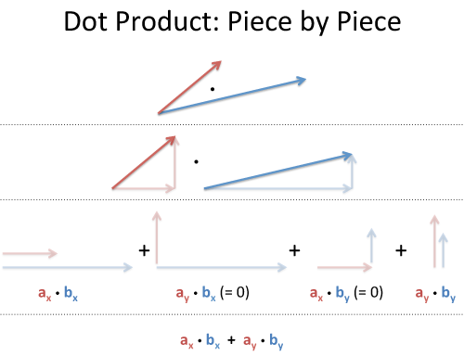

Rectangular Perspective of Dot Product

Slide 19
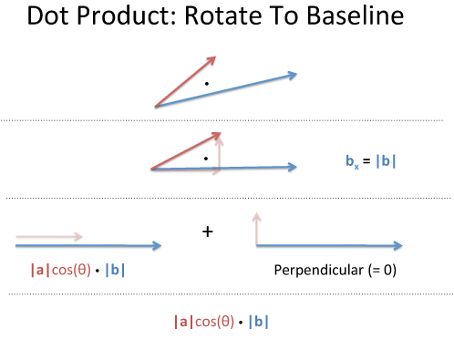


Polar Perspective of Dot Product
Take two vectors, a and b. Rotate our coordinates so b is horizontal: it becomes (|b|, 0), and everything is on this new x-axis. The dot product will not change.
Well, vector a has new coordinates (a1, a2), and we get:
a1 is really "What is the x-coordinate of a, assuming b is the x-axis?". That is |a|cos(θ), aka the "projection":

Slide 20
Text Analytics
Process of extracting high quality information from Text.
Text mining can help an organization derive potentially valuable business insights from text-based content such as word documents, email and postings on social media streams like Facebook, Twitter and LinkedIn.
Natural Language Processing is another term used for “Text Mining” or “Text Analytics”
The most basic method of doing text analytics is “bag of words”. It counts the number of times each word appears in a text and uses these counts as independent variables. It is used as baseline in text analytics and NLP projects
Before applying text analytics methods, pre-processing of the text can improve the quality of the analytics.

Slide 21
Examples of Text Classification
Topic Identification: Ex – Is this news article about Politics, Sports or Technology?
Spam detection: Ex- Is this mail spam or not?
Sentiment Analysis: Ex- Is this movie review Positive or Negative?
Spelling Correction: Ex Color or Colour? Which is the right spelling?

Slide 22
NLP tasks and Applications
Some commonly performed NLP tasks:
Counting Words, frequency of words
Sentence boundaries
Parts of Speech tagging (POS)
Parsing the sentence
Some Applications
Entity recognition
Co-reference resolution
Topic Modeling
Sentiment Analysis
Chatbots

Slide 23
Text Pre-Processing
Basic pre-processing includes:
Converting all text into all uppercase or lowercase, so that the algorithm does not treat the same words in different cases as different
Removing everything that isn’t a standard number or letter
Stop words like is, the, at etc can be removed
Stemming: It is used to represent words with different endings as the same word e.g argue, argued, argues and arguing can be represented by a single word
Lemmatization: A slight variant of stemming is lemmatization. Lemmatization is where you want to have the words that come out to be actually meaningful. The major difference between these is, as you saw earlier, stemming can often create non-existent words, whereas lemmas are actual words.

Slide 24
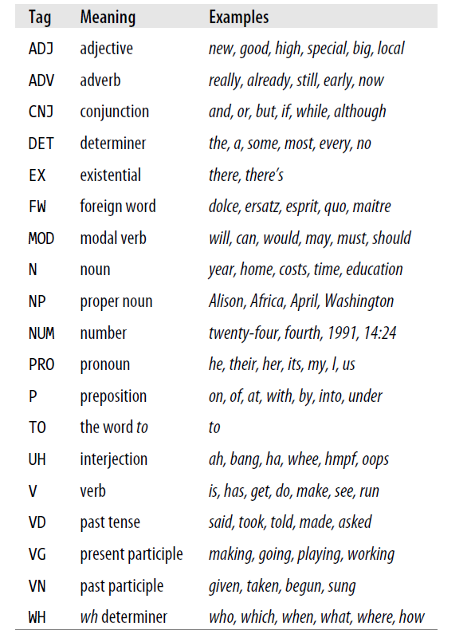
Parts of Speech Tagging
Some tags:

Slide 25
Types of Textual Features
Words
Characterstics of Words: Capitalization
Parts of Speech
Sentence Parsing: Ex- How far the verb is from associated noun
Grouping words of similar meaning
Using pair or triplet of words as 1 feature: Bigrams or trigrams. E.g White House should be used together as 1 feature

Slide 26
Bag of Words
The bag-of-words model is a way of representing text data
A bag-of-words is a representation of text that describes the occurrence of words within a document. It involves two things:
A vocabulary of known words.
A measure of the presence of known words.
Before applying bag of words, preprocessing should be done, to improve the performance.
It is called a “bag” of words, because any information about the order or structure of words in the document is discarded. The model is only concerned with whether known words occur in the document, not where in the document.
The intuition behind Bag of Words is that documents are similar if they have similar content. Further, that from the content alone we can learn something about the meaning of the document.

Slide 27
Bag of Words - Example
Below is a snippet of the first few lines of text from the book “A Tale of Two Cities” by Charles Dickens:
It was the best of times, it was the worst of times, it was the age of wisdom, it was the age of foolishness
Step 1: Get unique words:
The unique words here (ignoring case and punctuation) are:
“it”
“was”
“the”
“best”
“of”
“times”
“worst”
“age”
“wisdom”
“foolishness”
This is a vocabulary of 10 words from a corpus containing 24 words.

Slide 28
Bag of Words - Example
Step 2: Score the words
The purpose is to turn each document of free text into a vector that we can use as input or output for a machine learning model. The simplest scoring method is to mark the presence of words as a boolean value, 0 for absent, 1 for present.
“It was the best of times“= [1, 1, 1, 1, 1, 1, 0, 0, 0, 0]
"it was the worst of times" = [1, 1, 1, 0, 1, 1, 1, 0, 0, 0]
"it was the age of wisdom" = [1, 1, 1, 0, 1, 0, 0, 1, 1, 0]
"it was the age of foolishness" = [1, 1, 1, 0, 1, 0, 0, 1, 0, 1]
New documents that overlap with the vocabulary of known words, but may contain words outside of the vocabulary, can still be encoded, where only the occurrence of known words are scored and unknown words are ignored.
Additional simple scoring methods include:
Counts. Count the number of times each word appears in a document.
Frequencies. Calculate the frequency that each word appears in a document out of all the words in the document.

Slide 29
TF-IDF
A problem with scoring word frequency is that highly frequent words start to dominate in the document (e.g. larger score), but may not contain as much “informational content” to the model as rarer but perhaps domain specific words. Also, it will give more weightage to longer documents than shorter documents.
One approach is to rescale the frequency of words by how often they appear in all documents, so that the scores for frequent words like “the” that are also frequent across all documents are penalized.
This approach to scoring is called Term Frequency – Inverse Document Frequency, or TF-IDF for short, where:
Term Frequency: is a scoring of the frequency of the word in the current document.
Inverse Document Frequency: is a scoring of how rare the word is across documents.
TF = (Number of times term t appears in a document)/(Number of terms in the document)
IDF = 1+log(N/n), where, N is the number of documents and n is the number of documents a term t has appeared in.
The scores are a weighting where not all words are equally as important or interesting.

Slide 30
Finding Similarity using TF-IDF
Lets say we have 3 documents and we have to do a search on these documents with the following query: ”life learning”. We need to find out which document is most similar to our query.
Document 1: The game of life is a game of everlasting learning
Document 2: The unexamined life is not worth living
Document 3: Never stop learning
Step 1: Term Frequency (TF)
Document 1: Total terms in this document is 10
the – 1/10, game – 2/10, of – 1/10, life – 1/10, is -1/10, a-1/10, everlasting-1/10, learning-1/10
Document 2: Total terms in this document is 7
the-1/7, unexamined-1/7, life-1/7, is-1/7, not-1/7, worth-1/7, living-1/7
Document 3: Total terms in this document is 3
Never-1/3, stop-1/3, learning-1/3

Slide 31
Finding Similarity using TF-IDF
Step 2: Inverse Document Frequency (IDF)
IDF for the term game:
IDF(game) = 1 + log(Total Number Of Documents / Number Of Documents with term game in it)
There are 3 documents in all = Document1, Document2, Document3
The term game appears in Document1
IDF(game) = 1 + loge(3 / 1)
= 1 + 1.098726209
= 2.098726209

Slide 32
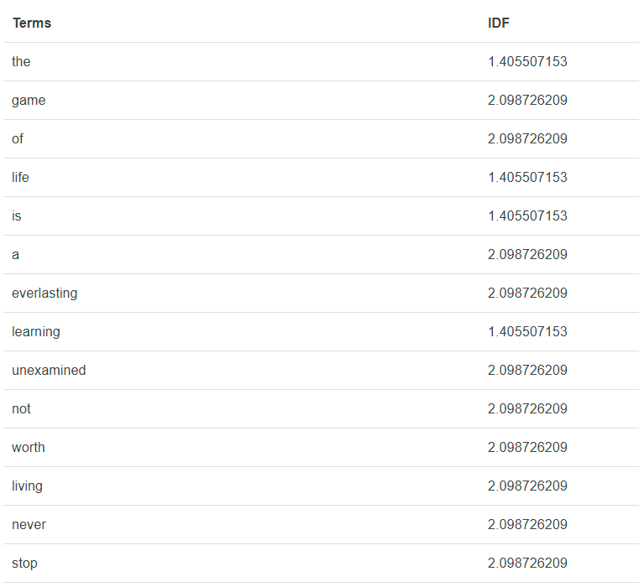
Finding Similarity using TF-IDF
Given is the IDF for terms occurring in all the documents. Since the terms: the, life, is, learning occurs in 2 out of 3 documents they have a lower score compared to the other terms that appear in only one document.

Slide 33
Finding Similarity using TF-IDF
Step 3: Calculate TF* IDF
The query was: “life learning”
Life:
Document1: 0.1 * 1.405507153 = 0.140550715
Document2: (1/7)* 1.405507153 = 0.200786736
Document 3: 0
Learning:
Document1: 0.1 * 1.405507153 = 0.140550715
Document2: 0
Document 3: 0.468502384

Slide 34
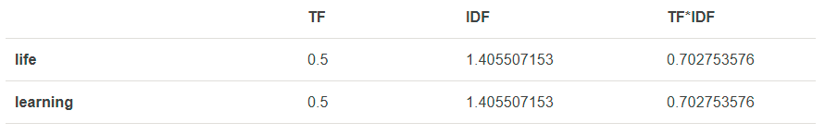
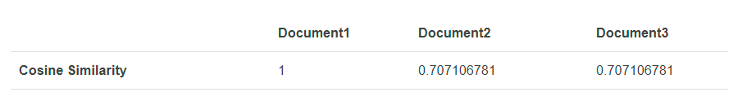
Finding Similarity using TF-IDF
Step 4: Cosine Similarity
The set of documents in a collection then is viewed as a set of vectors in a vector space. Each term will have its own axis. Using the formula given below we can find out the similarity between any two documents.
Cosine Similarity (d1, d2) = Dot product(d1, d2) / ||d1|| * ||d2||
TF-IDF for the query: Life Learning

Slide 35
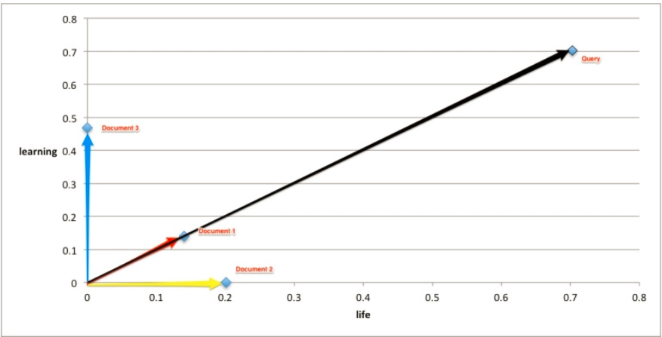
Finding Similarity using TF-IDF
Document 1 is most similar to the query

Slide 36
Chatbot
There are two major types of chatbots: chatbots for entertainment and chatbots for business.
Chatbots for business are generally transactional, and they have a specific purpose. Conversation is typically focused on user’s needs. E.g Travel chatbot is providing an information about flights, hotels, and tours and helps to find the best package according to user’s criteria.
A chatbot is based on either of the 2 models: Retrieval Based or Generative
In retrieval-based models, a chatbot uses some heuristic to select a response from a library of predefined responses. The chatbot uses the message and context of conversation for selecting the best response from a predefined list of bot messages. The context can include current position in the dialog tree, all previous messages in the conversation, previously saved variables (e.g. username)
Heuristics for selecting a response can be engineered in many different ways, from rule-based if-else conditional logic to machine learning classifiers.
Generative models are the future of chatbots, they make bots smarter. This approach is not widely used by chatbot developers, it is mostly in the labs now. The idea is to generate a response from scratch

Slide 37
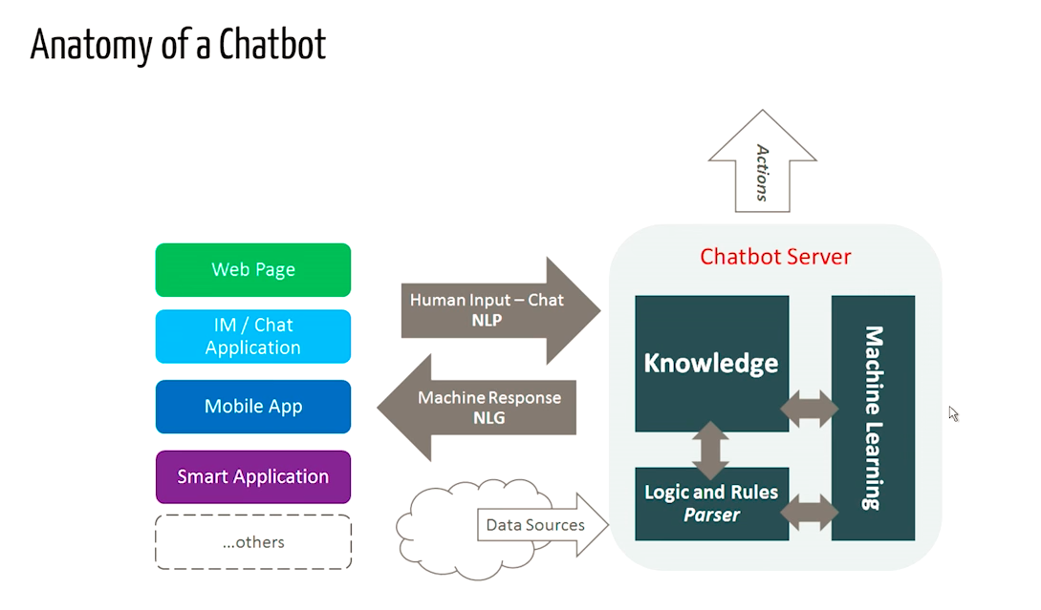
Chatbot

